Slide 1

Select Topics in Python
Unsupervised Learning
Adwith Malpe

Slide 2
Objectives
Objectives
What is unsupervised learning?
What is the process of unsupervised learning?
Unsupervised learning algorithms.
Applications of unsupervised learning.

Slide 3
What is Unsupervised Learning?
What is unsupervised learning?
Branch of machine learning that refers to a class of systems and algorithms that establishes a predictive model without a ground truth (the existence of labeled data).
Basic concept: train a model using unlabeled input and output data and then apply the model to new data to make predictions.
Unknown ground truth and many samples available.
Can analyze and cluster unlabeled datasets.

Slide 4
Unsupervised Learning Process
Unsupervised learning process
Gather training data (no labeled data).
Split the unlabeled data into a training set and test set.
Train the model.
Test the model.
Evaluate the model using data it has not seen.

Slide 5
Unsupervised Learning Algorithms
Unsupervised learning algorithms
K-means clustering.
DBSCAN.

Slide 6
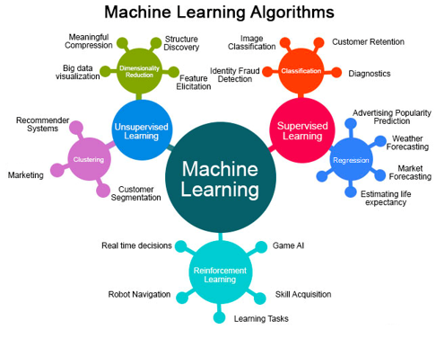
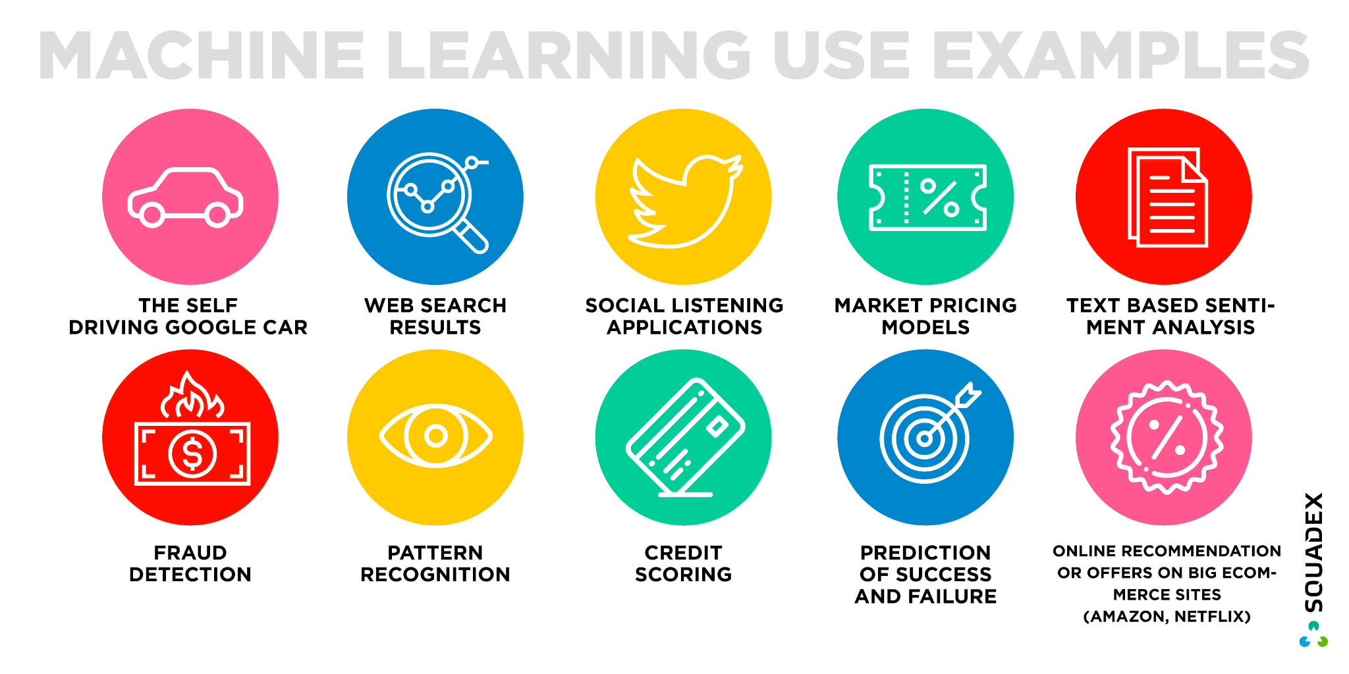
Applications of Unsupervised Learning

